Slide 1
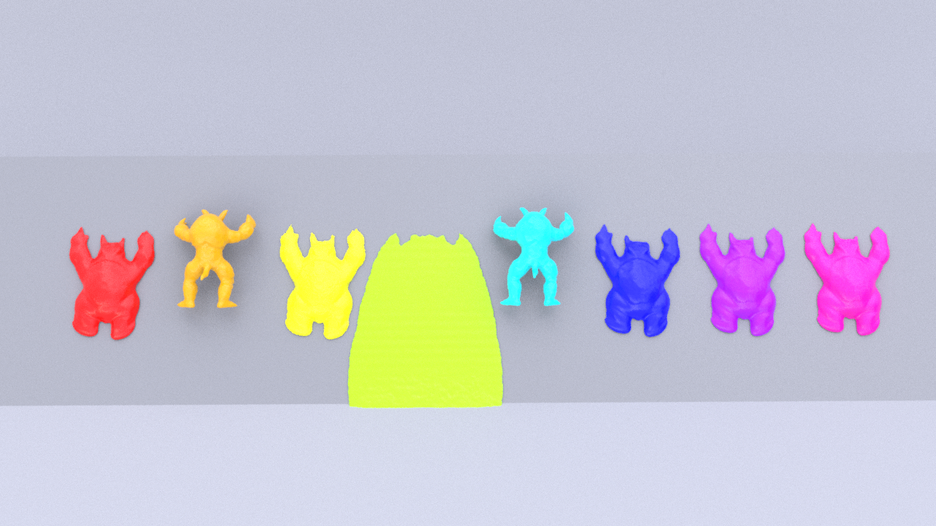

A Unified Particle-Based Solver for Non-Newtonian Behaviors Simulation
Chunlei Li¹, Yang Gao^{1 ,2†}, Jiayi He¹, Tianwei Cheng¹, Shuai Li^{1,2,3},
Aimin Hao^{1,2,4}, Hong Qin⁵
¹State Key Laboratory of Virtual Reality Technology and Systems, Beihang University, China
²Research Unit of Virtual Body and Virtual Surgery (2019RU004), Chinese Academy of Medical Sciences, Beijing 100050, China
³Zhongguancun Laboratory, Beijing 100094, China
⁴Peng Cheng Laboratory, Shenzhen 518066, China
⁵Department of Computer Science, Stony Brook University (SUNY at Stony Brook), Stony Brook, New York 11794-2424, USA
†corresponding author: gaoyangvr@buaa.edu.cn,qin@cs.stonybrook.edu
This video contains voice over, please use headphone or speakers.
Notes:
In this video, we will give an intuitive introduction to our particle based non-Newtonian solver and then present additional visual results of our experiments.

Slide 2
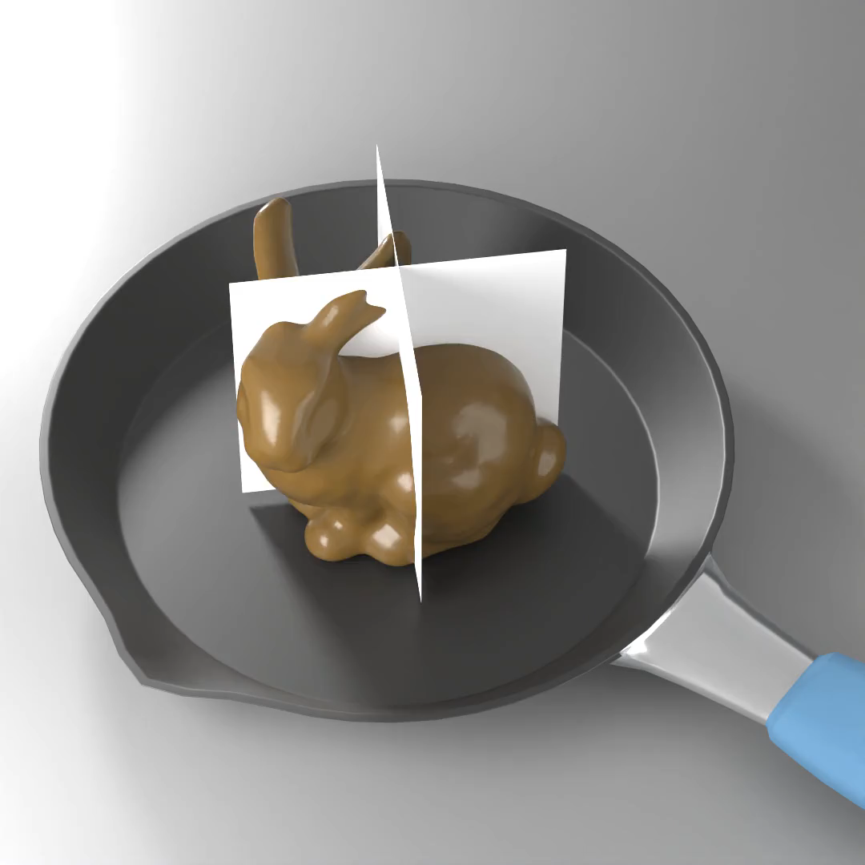
Unified particle-based method
A pure particle-based model to simulate most of non-Newtonian behaviors, from fluid-like to solid like.
Shear rate driven viscosity
Six shear rate driven rehological models to reproduce the classic shear-thinning, shear-thickening and Bingham behaviors.
Viscosity, elasticity and plasticity
Using Generalized Maxwell Model to physically meanfully tackle the relationship between viscosity, elasticity and plasticity and empower our solver the capability of dealing with time-dependent nonlinearity.
Notes:
Our solver is focus on the non-Newtonian behaviors simulation, which is a classic topic in graphcal community.
Compared to other works, our work stands out in the following three aspects:
First, our method is purely particle based. By simply modifying the stress term of N-S equation under SPH framework, our solver covers a wide range of rheological materials, including substance from fluid-like to solid-like.
Second, we have implemented six classic shear-dependent viscosity models. These models are able to simulate shear-thinning, shear-thickening, and Bingham fluid behaviors, which collectively encompass the majority of non-Newtonian phenomena.
Third, we elegantly and concisely integrate viscosity, elasticity, and plasticity into a unified framework. We utilize the Generalized Maxwell model to vividly and physical meaningfully interpret our constitutive model.

Slide 3
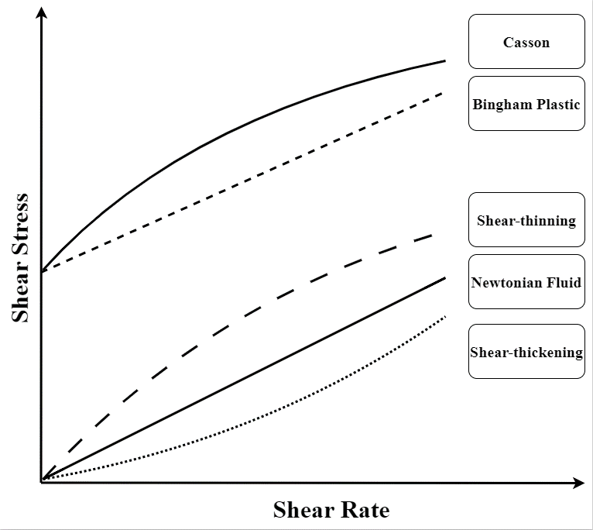
Classifications of Non-Newtonian
Newtonian fluid
Stress vs. strain rate is linear
Non-Newtonian Material
Time independent: Shear rate driven
Shear-thinning
Shear-thickening
Bingham
Bingham plastic(w/o shear-thinning)
Casson(with shear-thinning)
Time-denpendent
visco-elasticity and plasticity
Notes:
Non-Newtonian fluids differ from Newtonian fluids in that they display nonlinear stress-strain rate relationships.
There are two types of nonlinearity: time-independent and time-dependent.
For time-independent non-linearity, we can use the shear rate driven models to give a spatially variable viscosity to model it.
As shown in the diagram, shear-thickening fluids exhibit an increase in viscosity with increasing shear rate, and vice versa for shear-thinning fluids. Bingham-type fluids, including Casson fluids, have a non-zero stress at zero shear rate.
For the time-dependent nonlinearity, we modelled visco-elasticity and plasticity with generalized maxwell model, which will be discussed later.

Slide 4
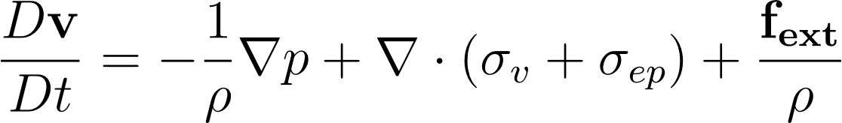
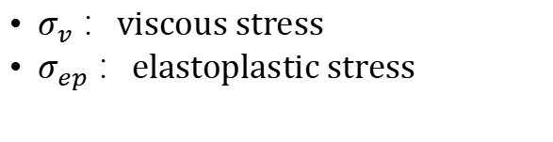
Governing Equation
$σ_{v}$ ：viscous stress
$σ_{ep}$ ：elastoplastic stress
Notes:
The major difference between our algorithm and others lies in the inclusion of both viscous stress and elasto-plastic stress in the Navier-Stokes equation in our solver. This is the key feature that enables our solver to handle non-Newtonian behavior.

Slide 5
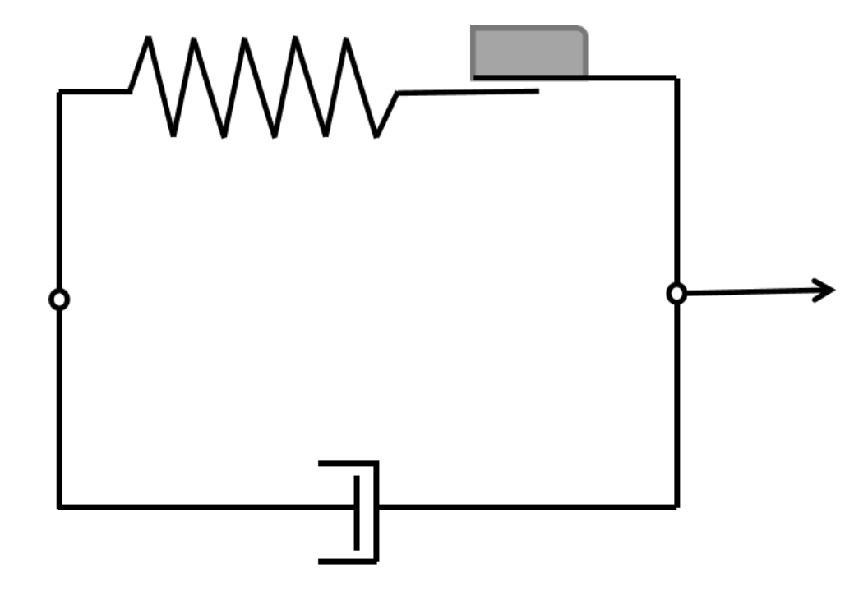
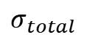
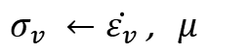
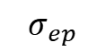
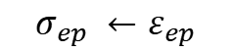
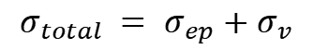
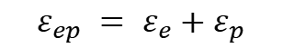
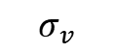
Constituitive Model: Generalized Maxwell Model
$$σ_{ep}$$
$$σ_{total} = σ_{ep}+σ_{v}$$
elasticity
plasticity
$$σ_{total}$$
$$σ_{ep} ←ε_{ep}$$
$σ_{v} ←\dot{ε_{v}}$ , $μ$
viscosity
$$ε_{ep} = ε_{e}+ε_{p}$$
$$σ_{v}$$
Notes:
We introduce Generalized Maxwell model to provide a physically meaningful explanation of the viscosity, elasticity, plasticity, and their interrelation.
In this diagram, the spring represents elasticity. The slider represents plasticity. And the dashpot in the bottom branch represents viscosity.
Total stress is divided into elasto-plastic stress and viscous stress.
The elasto-plastic stress is controlled by the elasto-plastic strain, which is further divided into elastic strain and plastic strain.
While the viscous stress is controlled the viscous strain rate and the viscosity.

Slide 6
Experiments and Comparisons
Notes:
From now on, we will demonstrate several experiments and Comparisons.

Slide 7
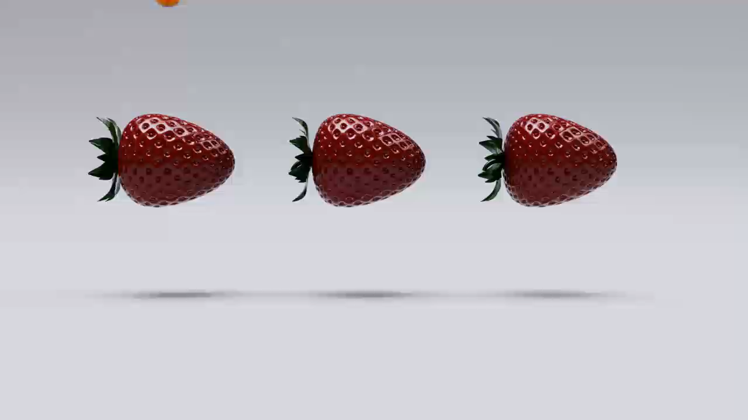
Comparison with Existing works
MPM
FLIP
SPH(Ours)
Notes:
Our SPH-based solver effectively tackles the high viscosity and supports additional features such as elastoplasticity and non-Newtonian viscosity.
We draw a comparison with two sate-of-the-art frameworks: FLIP by Shao et al in 2022 and MPM by Fang et al. in 2019.
In this scene where high-viscosity honey drips from strawberries, we observe that our solver performs as well as FLIP and even produces better results than MPM when handling high-viscosity substances.

Slide 8
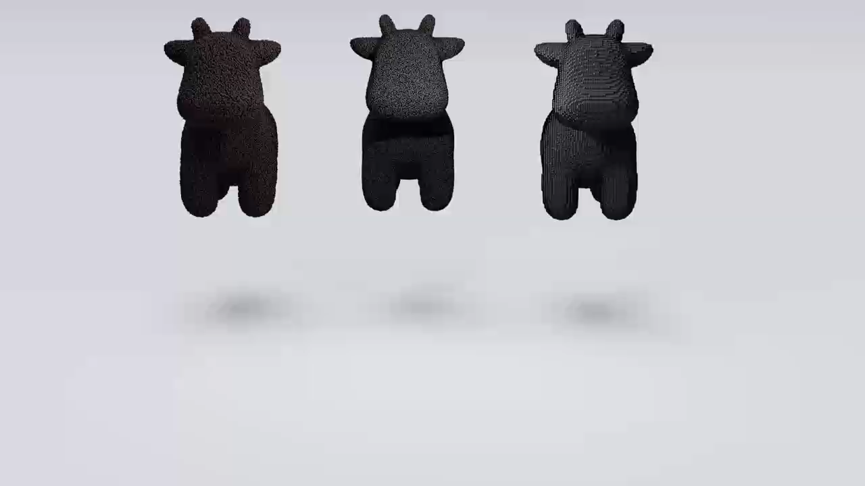
Comparison with Existing works
MPM
FLIP
SPH(Ours)
Notes:
Our framework demonstrates comparable result to the other two frameworks in simulating the falling of a viscous cow.

Slide 9
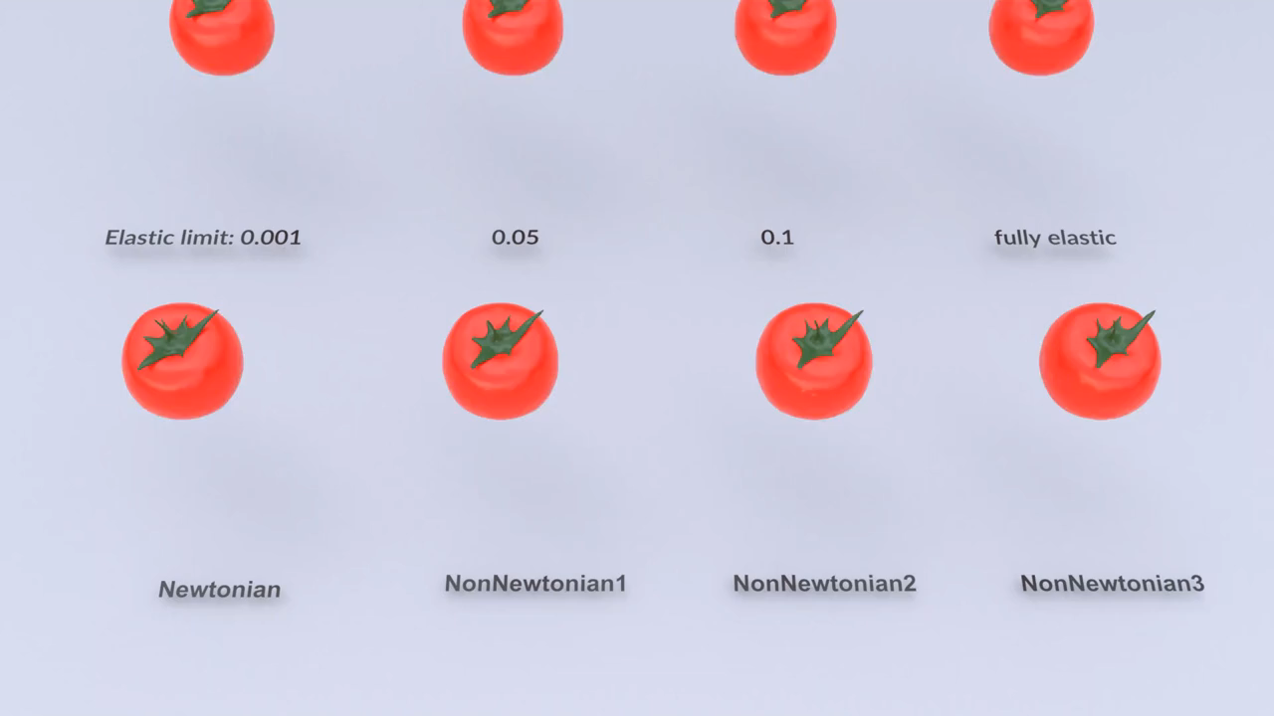
Visco-elasticity and visco-plasticity
Notes:
Our framework not only handles high-viscosity fluids effectively but also supports shear-dependent viscosity, viscoelasticity, and viscoplasticity. This extends its capabilities beyond traditional approaches for modeling complex fluid behaviors.
In this scene, the upper row tomatoes show solid-like behaviors with different elasto-plasticity and the lower row tomatoes show fluid-like behaviors with different viscous models.

Slide 10

Shear rate driven models
Carreau
Casson
Cross
PowerLaw2
PowerLaw1
Newtonian
HerschelBulkley
Bingham
Notes:
In this scenario, eight viscous armadilloes slide down a slope. Each armadillo adopts a different shear-dependent non-Newtonian model, including the Casson model, PowerLaw model, Carreau model, Cross model, Bingham model, and Herschel-Bulkley model, among others.

Slide 11
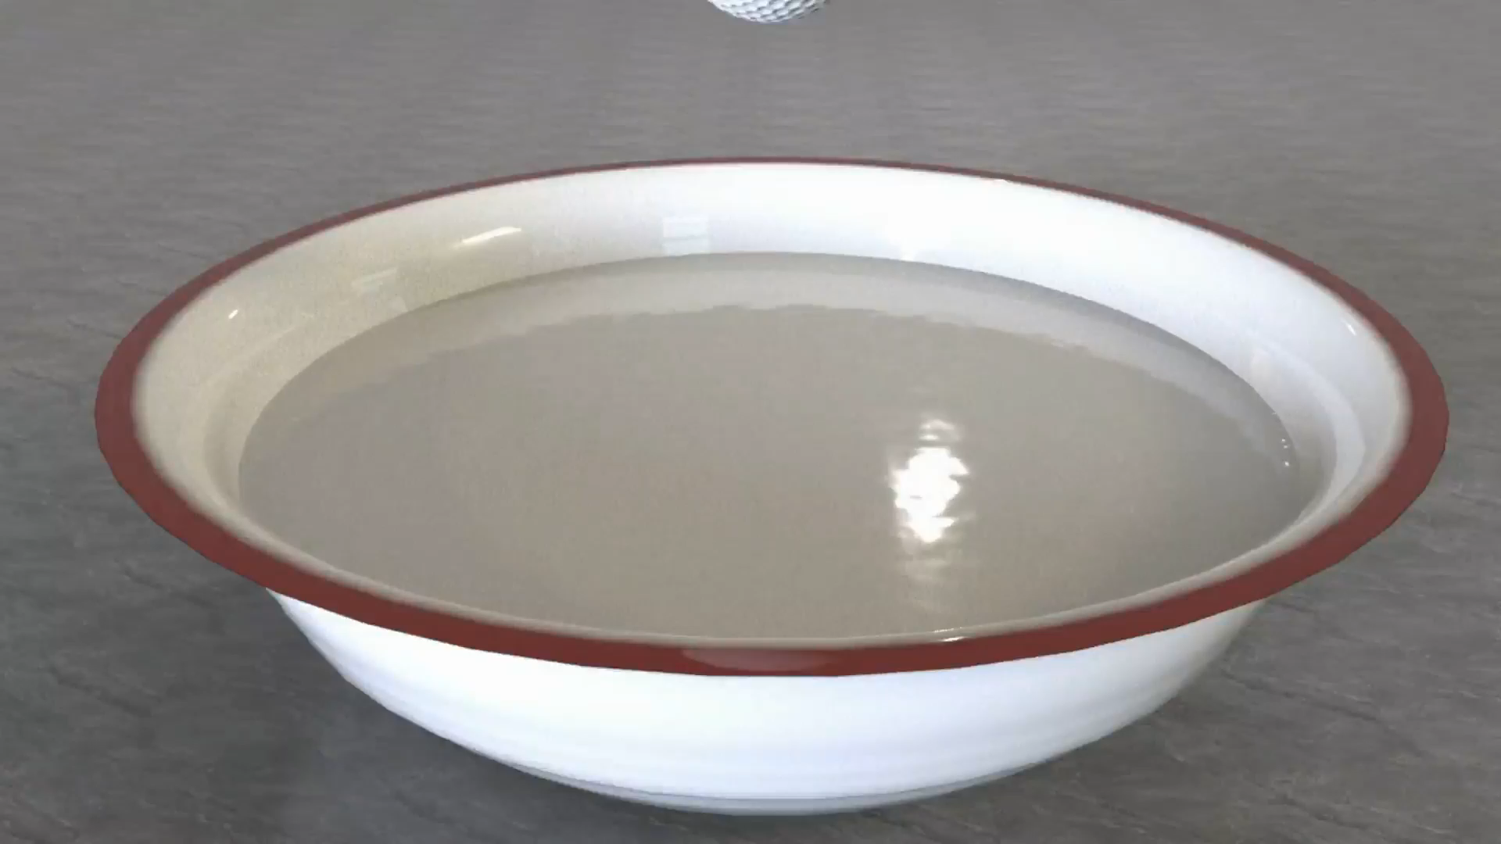
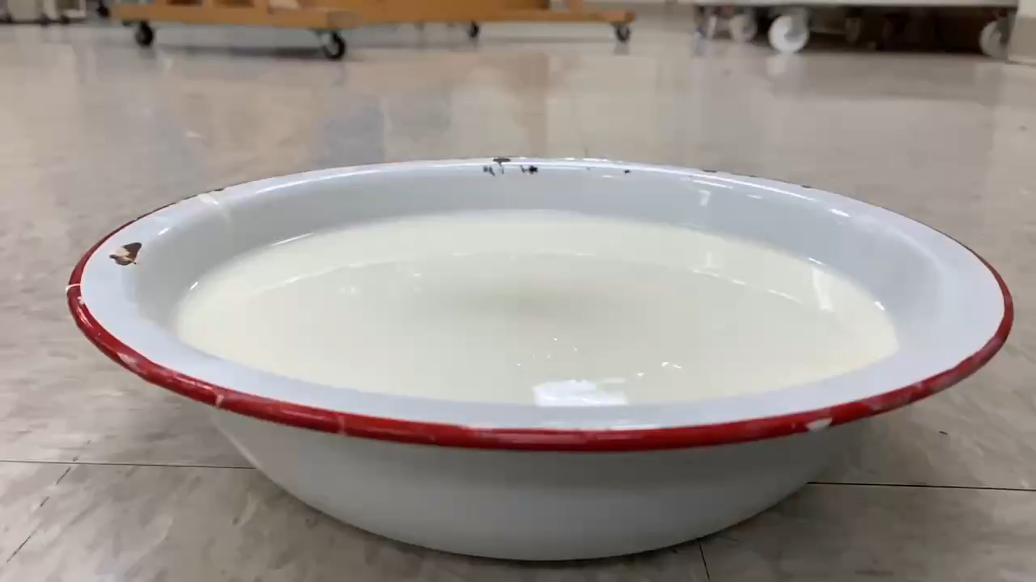
Classic shear-thickening phenomenon
Simulation
Real world video
Notes:
We have successfully replicated a classic non-Newtonian phenomenon: the impact of a golf ball dropping into a mixture of cornstarch.
Due to its shear-thickening properties, the ball experiences a rapid impact followed by a slow sinking motion.
Our simulation closely matches the recorded video results, demonstrating a high level of consistency between our model and real-world observations.

Slide 12
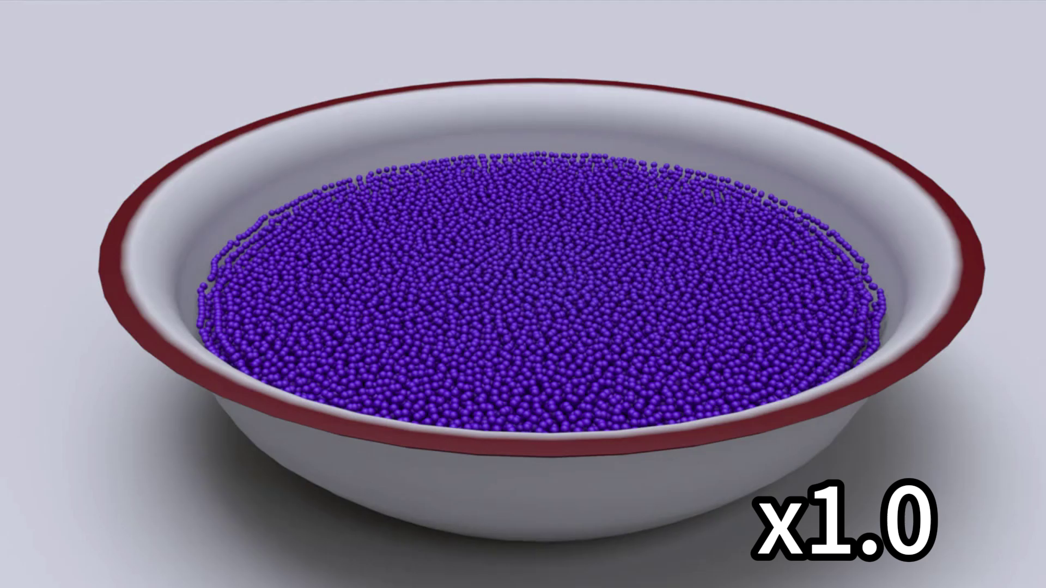
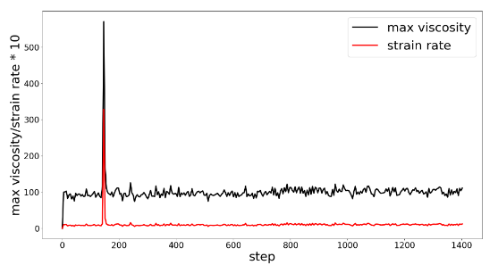
Classic shear-thickening phenomenon
Strain rate
30
0
Paritcle view
Notes:
We have successfully replicated a classic non-Newtonian phenomenon: the impact of a golf ball dropping into a mixture of cornstarch.
Due to its shear-thickening properties, the ball experiences a rapid impact followed by a slow sinking motion.
Our simulation closely matches the recorded video results, demonstrating a high level of consistency between our model and real-world observations.
The color of the particles represent their strain rate.

Slide 13

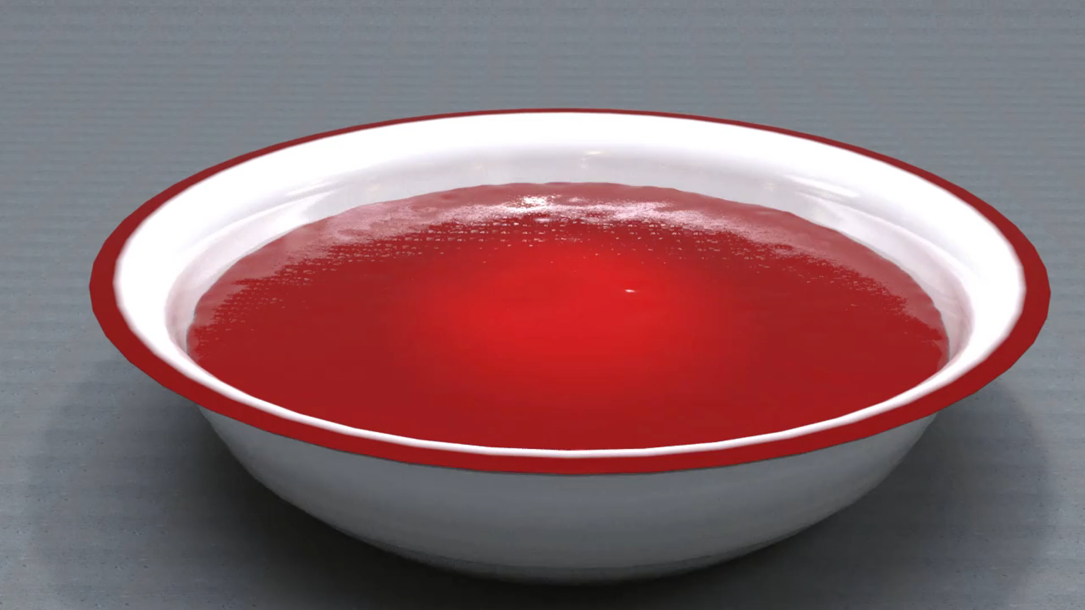
Cornstarch-water mixture and ketchup
Cornstarch-water mixture: slowly sinking
Ketchup: splashing
Notes:
If we keep other setup and change the fluid from cornsarch-water mixture to ketchup, which is a shear-thinning fluid, we will see completely different behavior.

Slide 14

Melting with heat diffusion
Notes:
With implementation of diffusion equation, our solver is able to simulate phase change such as ice-cream melting

Slide 15
Cutting and melting
Notes:
Thanks to the particle representation, our solver is easy to handle the topological change. For example, the chocolate bunny is cut while melting.

Slide 16
A Unified Particle-Based Solver for non-Newtonian Behaviors Simulation
Chunlei Li¹, Yang Gao^{1 ,2†}, Jiayi He¹, Tianwei Cheng¹, Shuai Li^{1,2,3},
Aimin Hao^{1,2,4}, Hong Qin⁵
¹State Key Laboratory of Virtual Reality Technology and Systems, Beihang University, China
²Research Unit of Virtual Body and Virtual Surgery (2019RU004), Chinese Academy of Medical Sciences, Beijing 100050, China
³Zhongguancun Laboratory, Beijing 100094, China
⁴Peng Cheng Laboratory, Shenzhen 518066, China
⁵Department of Computer Science, Stony Brook University (SUNY at Stony Brook), Stony Brook, New York 11794-2424, USA
†corresponding author: gaoyangvr@buaa.edu.cn, qin@cs.stonybrook.edu
Notes:
Thank you

